Slide 1
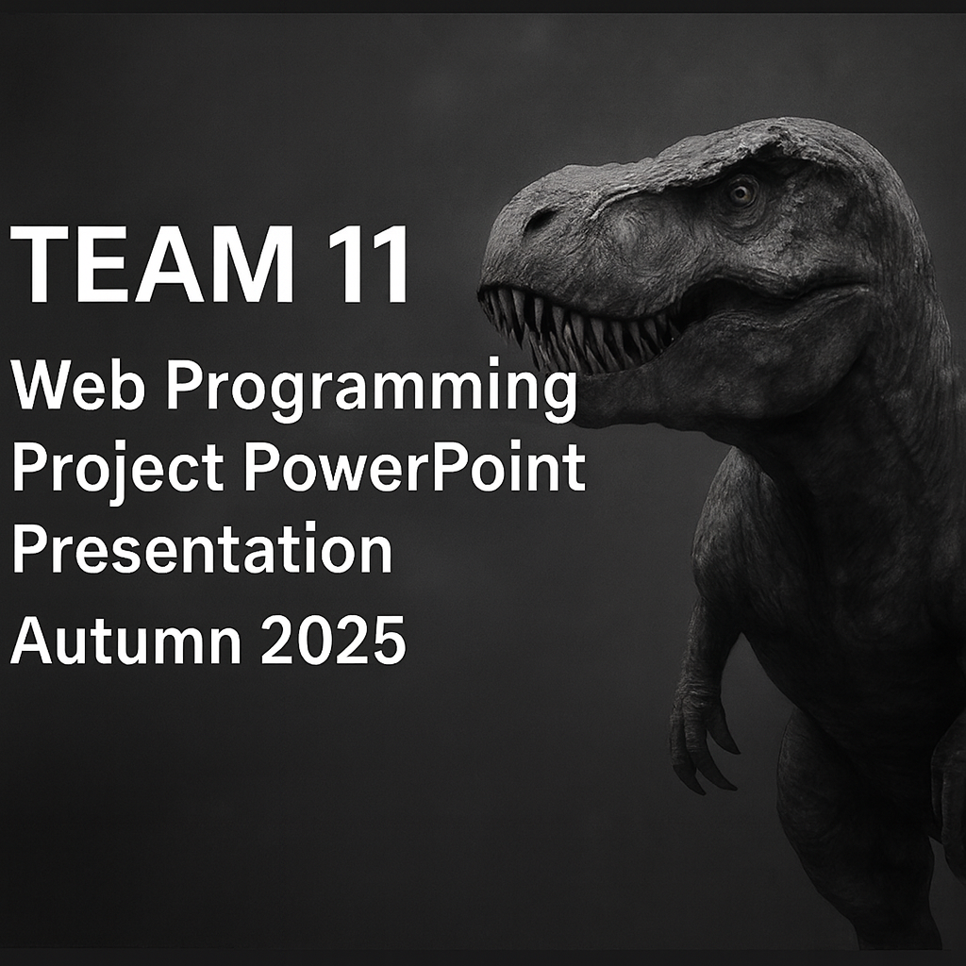
TEAM 11 – Web Programming Project
PowerPoint Presentation – Autumn 2025
[Add the grey T-rex background image here if desired]

Slide 2



Project Brand
Pink Baby Dragon Movie Hub
Our web application combines movie discovery, social features, and a touch of pink fire.
[Image placeholder – Pink Dragon logo here]

Slide 3
Team & Roles
Joonas Väyrynen Focused on backend database integration, Finnkino API, and REST API documentation. Contributed to testing and deployment setup.
Tommi Järvenpää Worked on the user interface, favorite list sharing, and user page creation. Ensured responsive layout and usability consistency.
Miro Hovi Implemented backend logic for login, logout, user creation, database operations, and group functionality. Also contributed to testing and documentation.
Antero Muunoja Coordinated overall architecture and design. Implemented authentication (JWT, bcrypt), MVC structure, database design, and worked in AI-assisted partnership throughout development. Supported all team members across backend, frontend, and documentation.

Slide 4
What We Learned
We deepened our understanding of the full-stack web architecture, teamwork, and version control. We learned to apply the MVC model, authentication flows, and database migrations in practice. Collaboration and communication were key factors for success — and we also learned to use AI tools effectively.

Slide 5
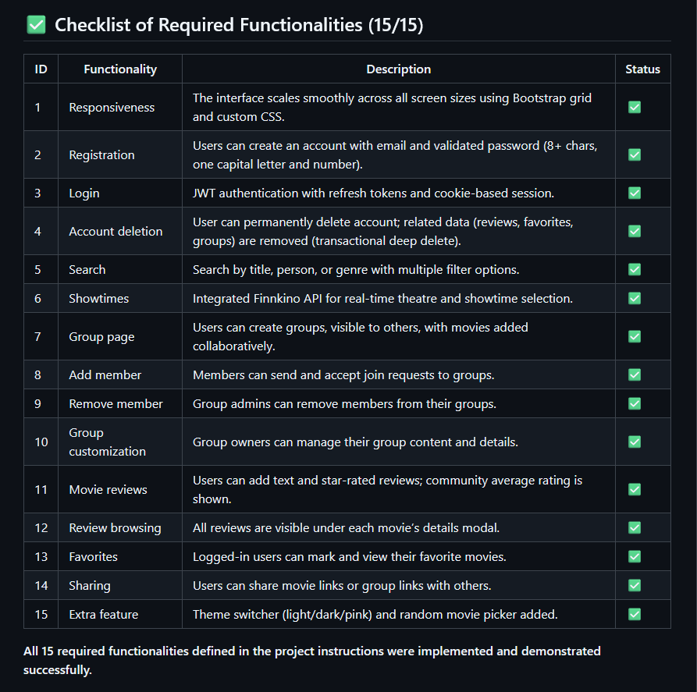
All 15/15 Functionalities Implemented
All required functionalities were implemented and demonstrated successfully.
[Image placeholder – Checklist image here]

Slide 6
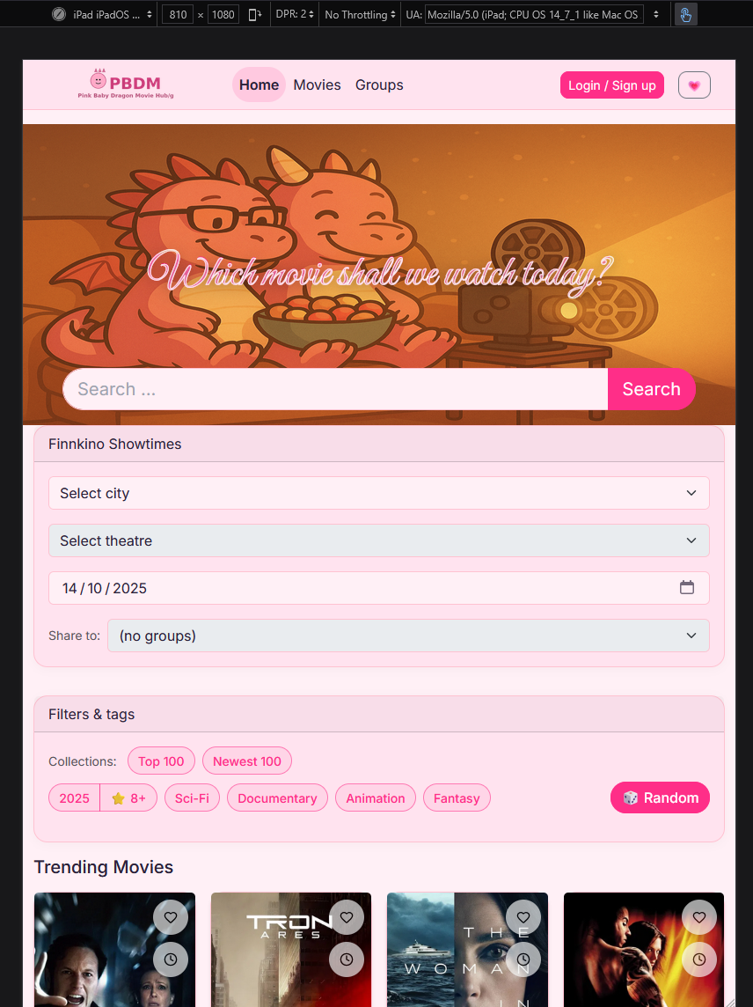
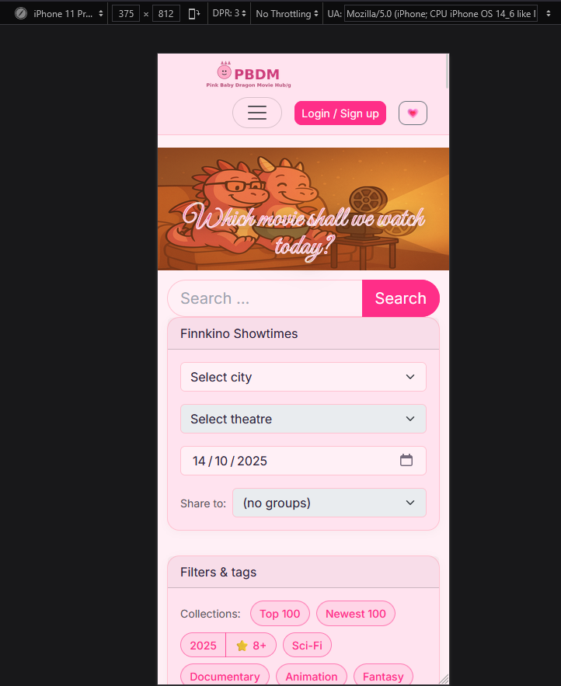
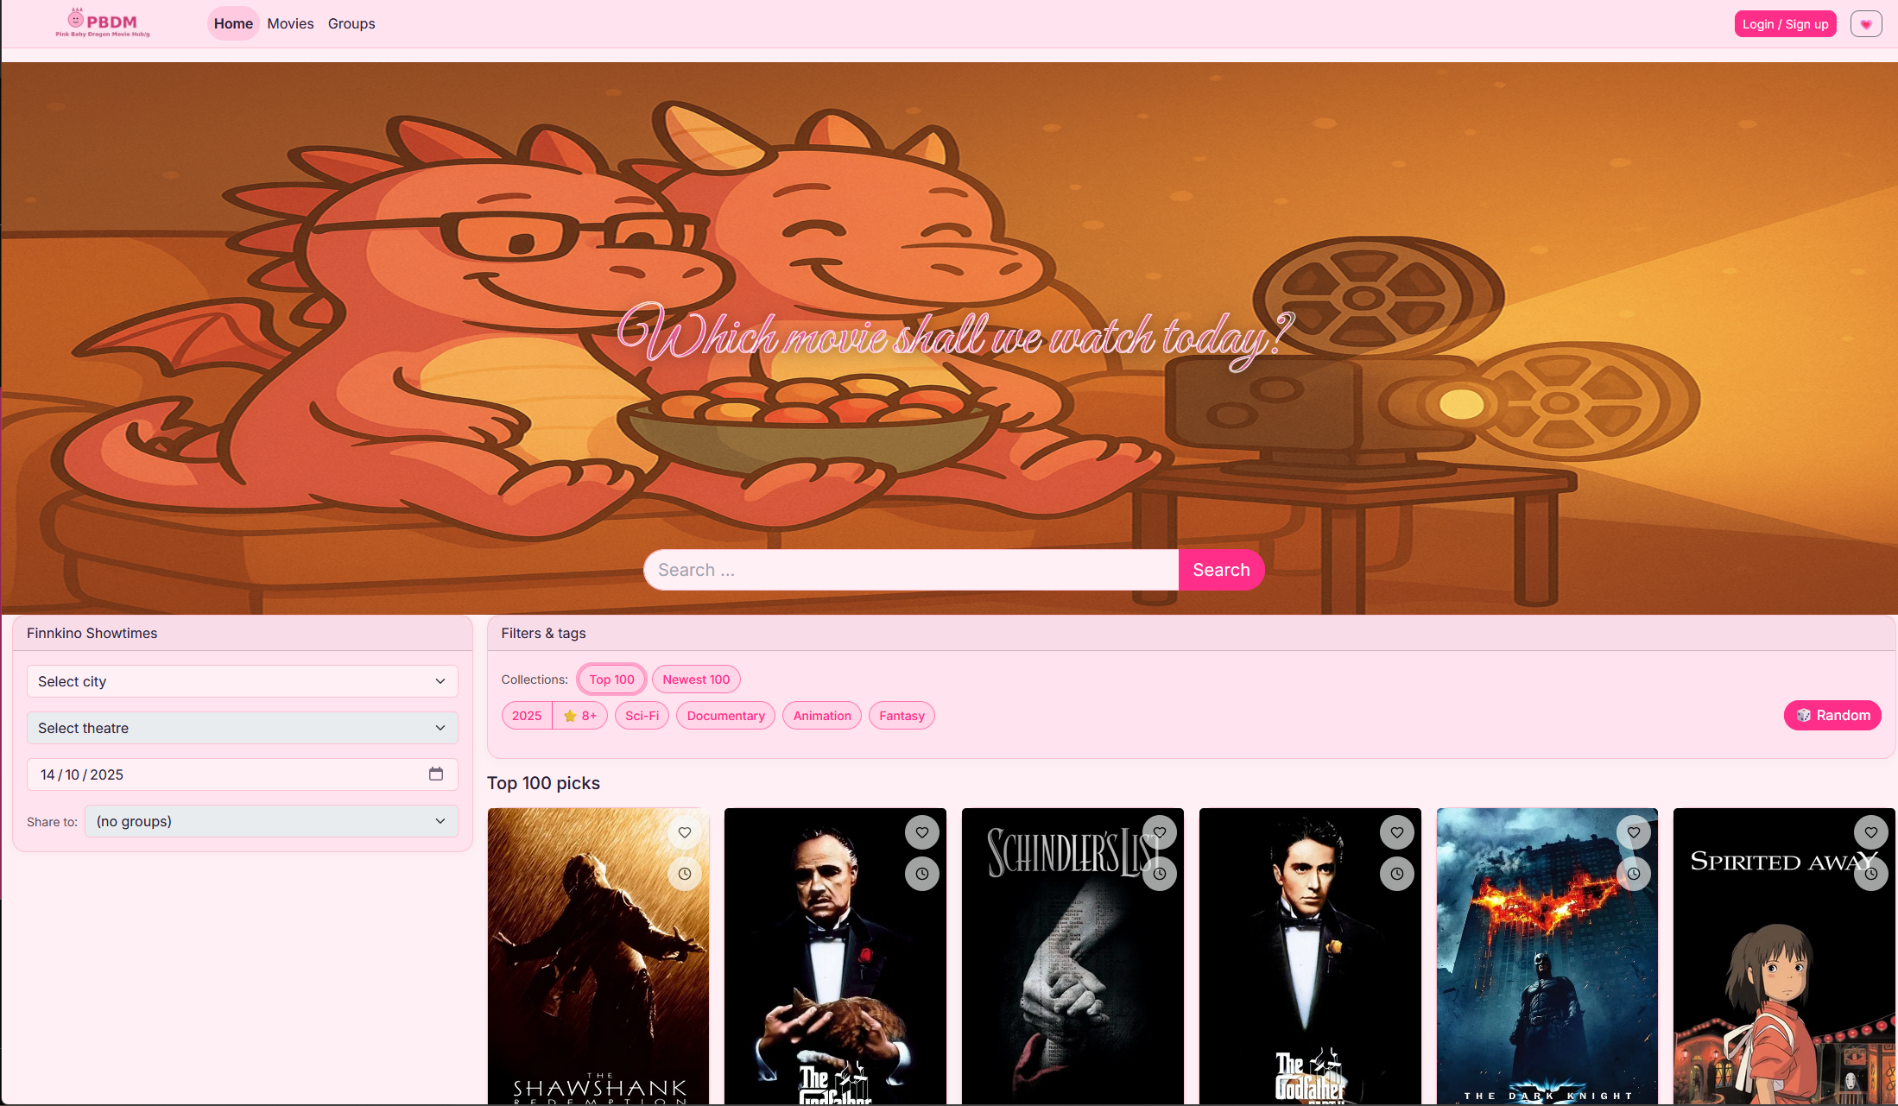
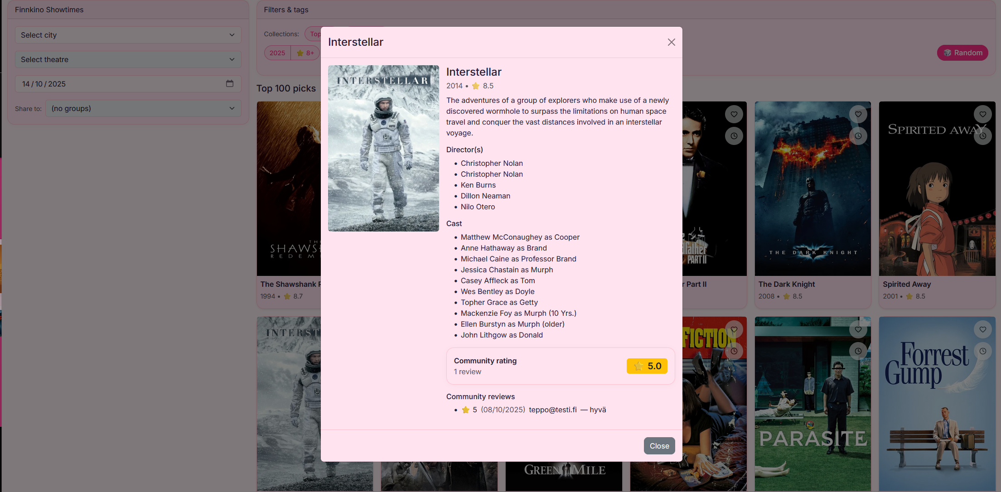
ID 1 – Responsiveness
The layout adapts dynamically to screen size using Bootstrap grid and media queries. Images and cards are optimized for mobile and desktop.
[Image placeholder – Left]
[Image placeholder – Right]

Slide 7
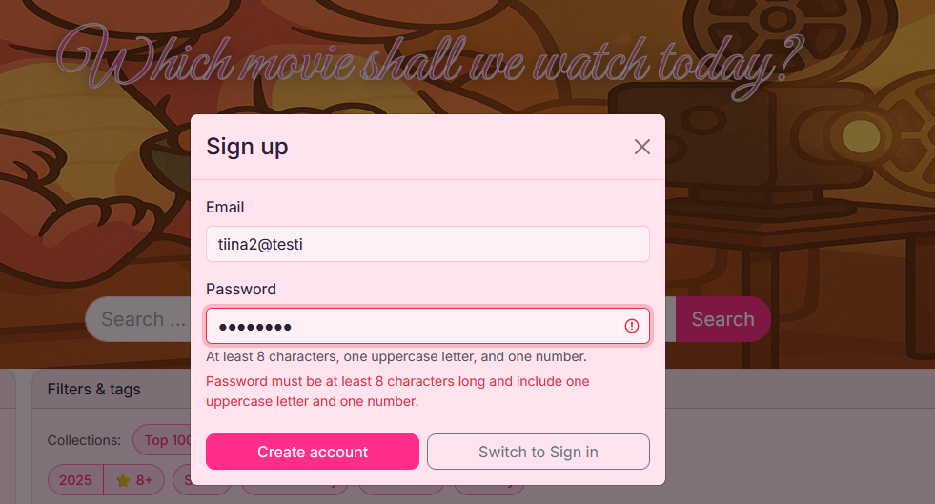
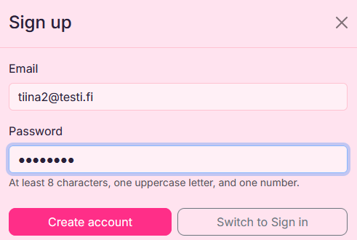
ID 2 – Registration
Secure user registration with hashed passwords (bcrypt) and input validation on both client and server.
[Image placeholder – Left]

Slide 8
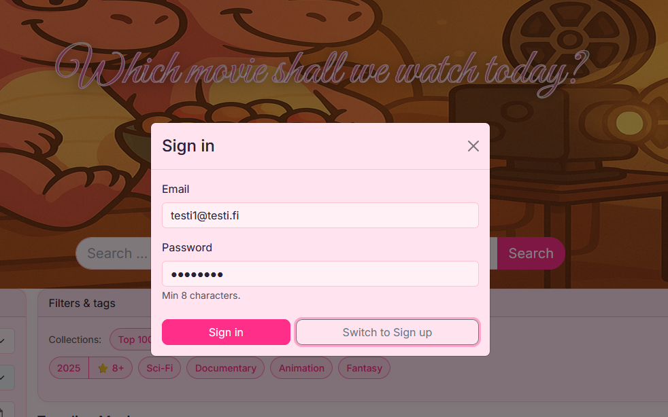
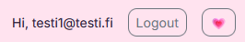
ID 3 – Login
JWT-based login flow with token storage and protected routes. Smooth UX with error feedback.

Slide 9
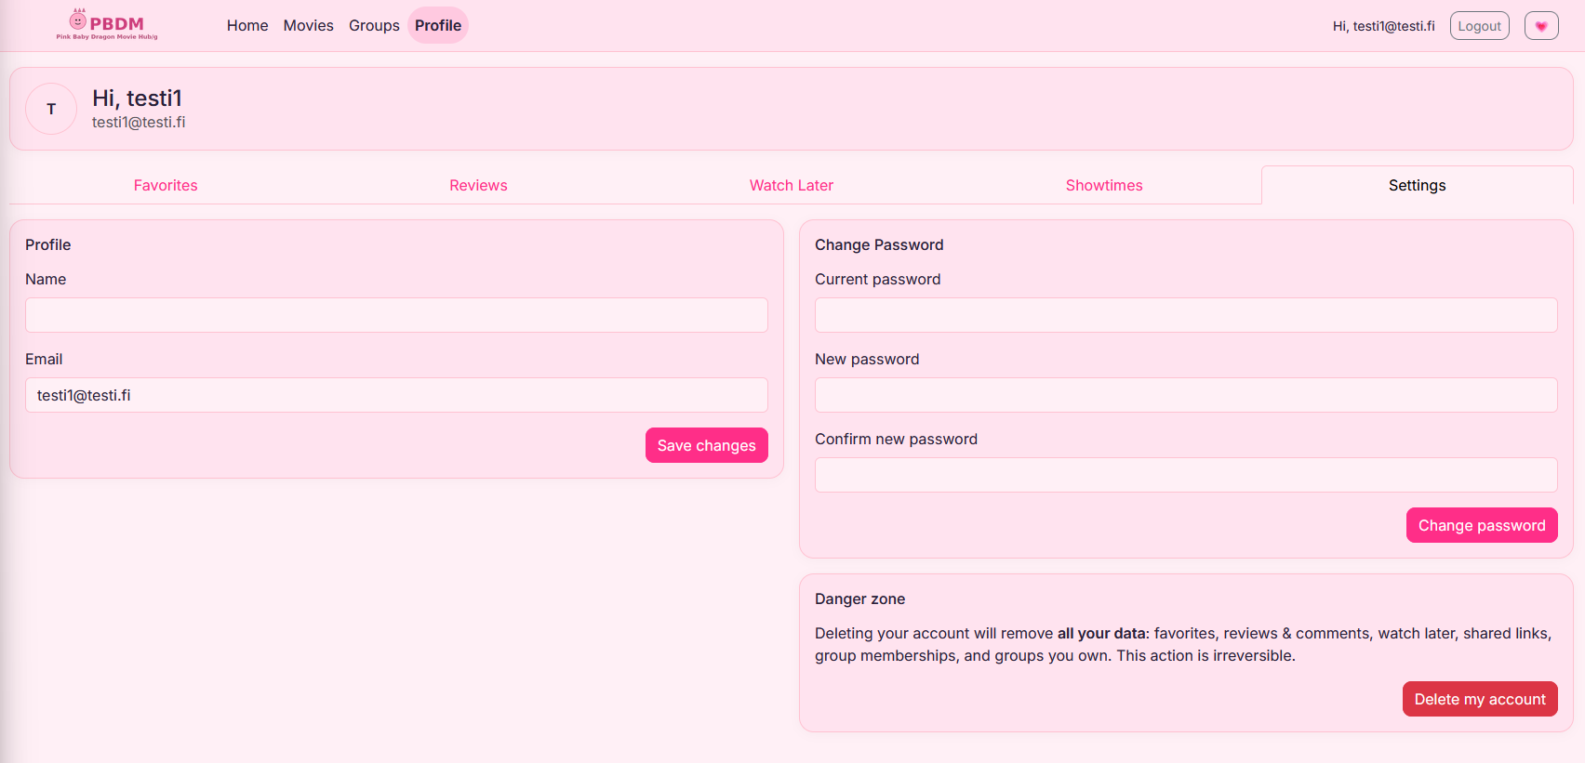
ID 4 – Account Deletion
Transactional deep delete to remove user and related data consistently and safely.

Slide 10
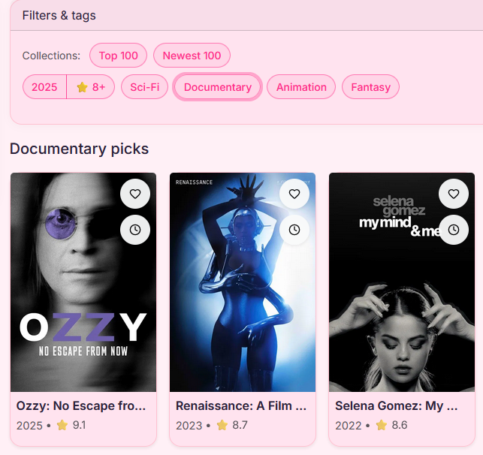
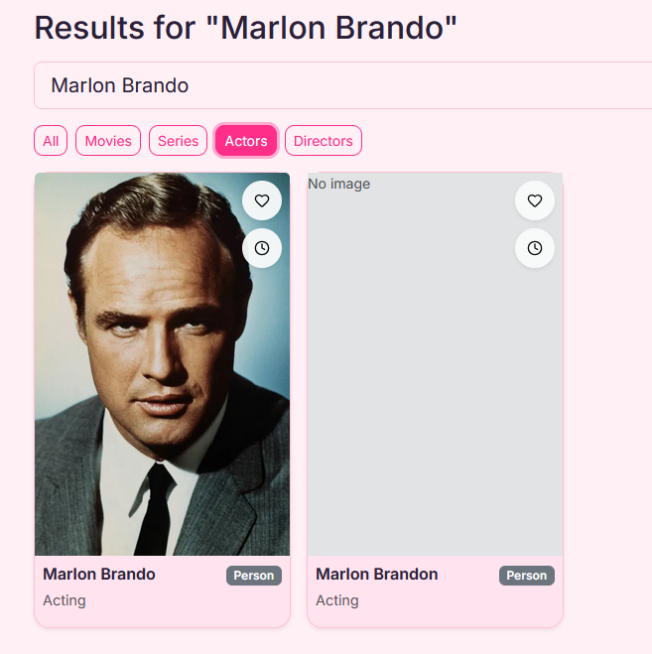
ID 5 – Search
TMDB-powered search with debounced queries and clean result mapping for titles, years, and ratings.
[Image placeholder – Right]

Slide 11
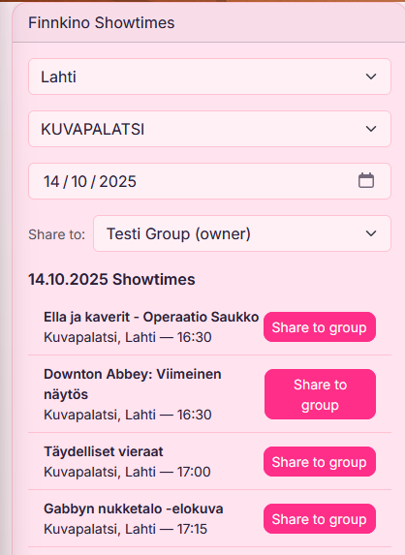
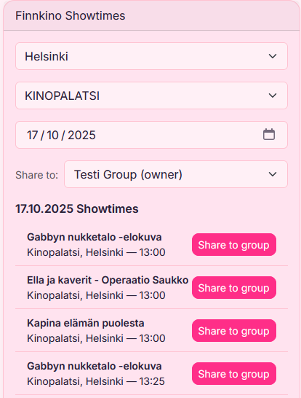
ID 6 – Showtimes (Finnkino Integration)
Finnkino integration retrieves showtimes dynamically using public API. Parsed date and time are converted into Postgres timestamptz format for consistent storage.

Slide 12
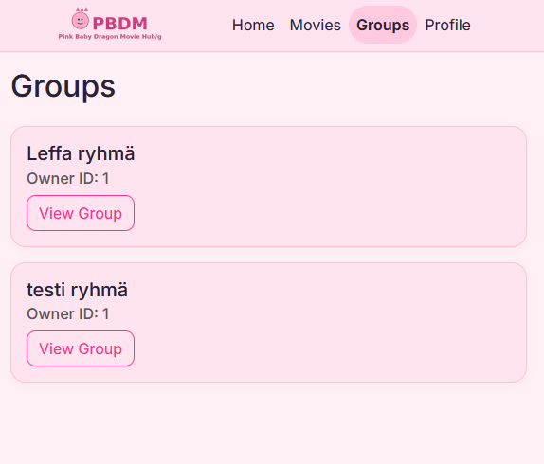
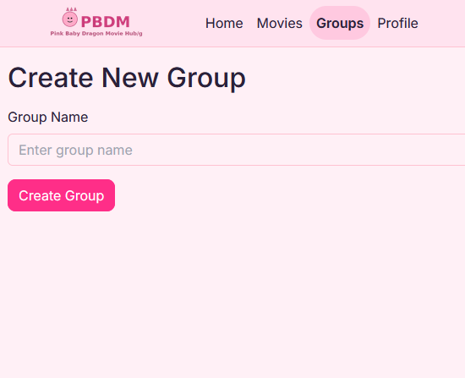
ID 7 – Group Page
Each group has its own page showing members and shared movies. Role-based permissions control what actions are available.

Slide 13
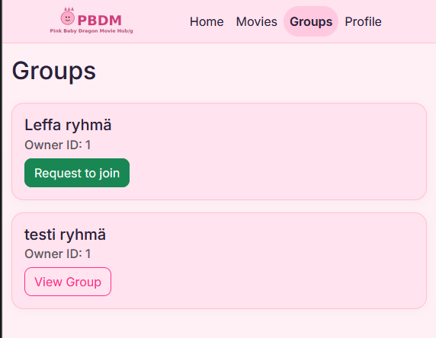
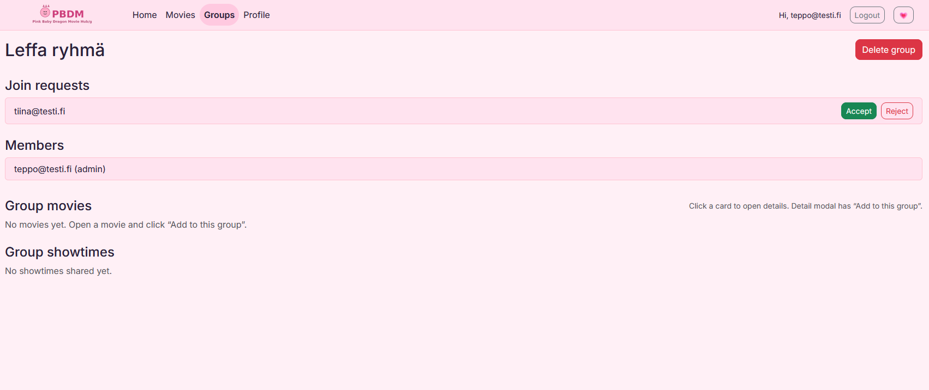
ID 8 – Add Member
Users can invite or add new members to a group. Pending requests are displayed until approved by an admin.
[Image placeholder – Left]
[Image placeholder – Right]

Slide 14
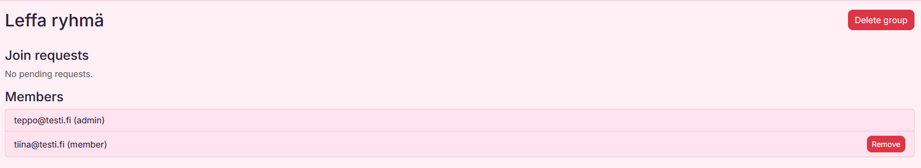
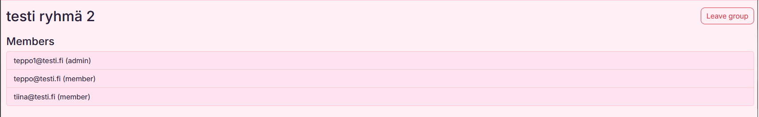
ID 9 – Remove Member
Admins can remove group members safely. Deletions update both database and interface immediately.
[Image placeholder – Left]
[Image placeholder – Right]

Slide 15
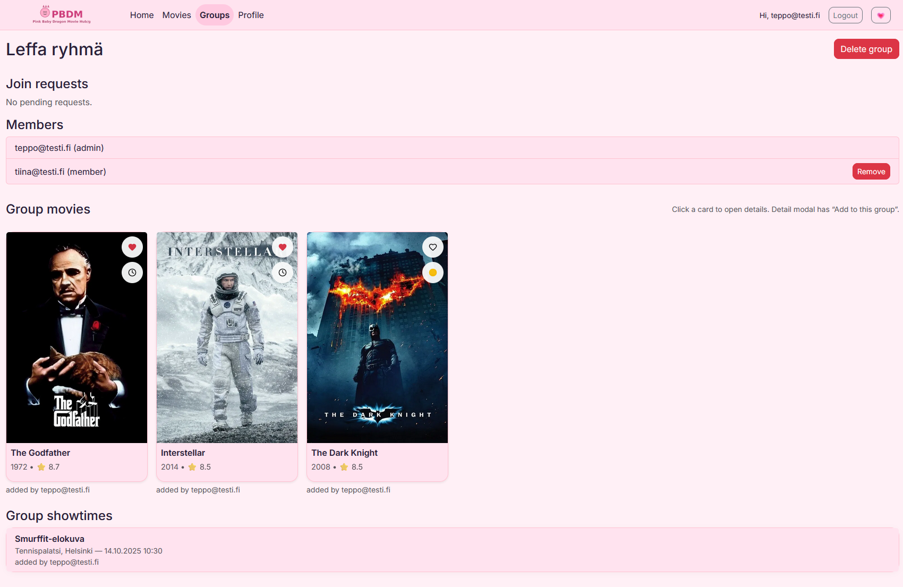
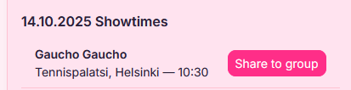
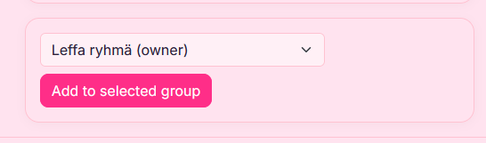
ID 10 – Group Customization
Groups can personalize their page with name and description fields stored in the database.
[Image placeholder – Left]

Slide 16
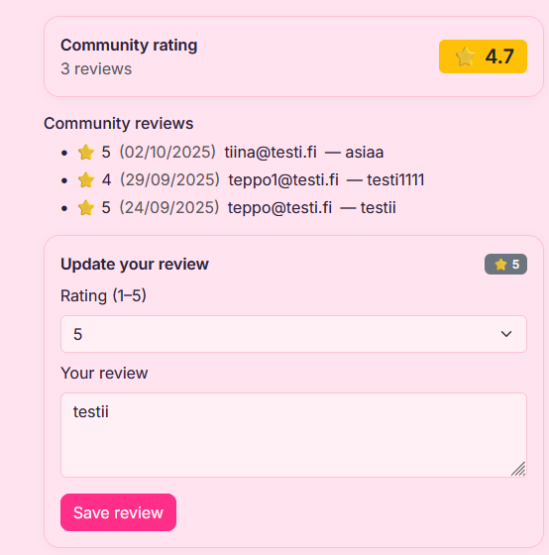
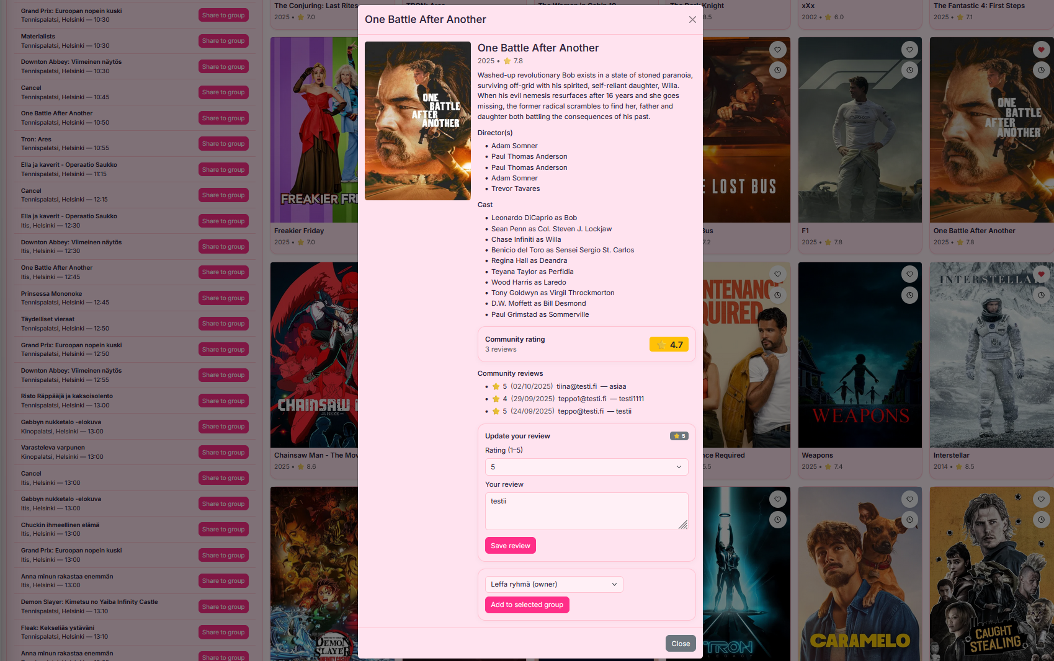
ID 11 – Movie Reviews
Users can write and rate movie reviews (1–5). Reviews are linked to both users and movie IDs.

Slide 17
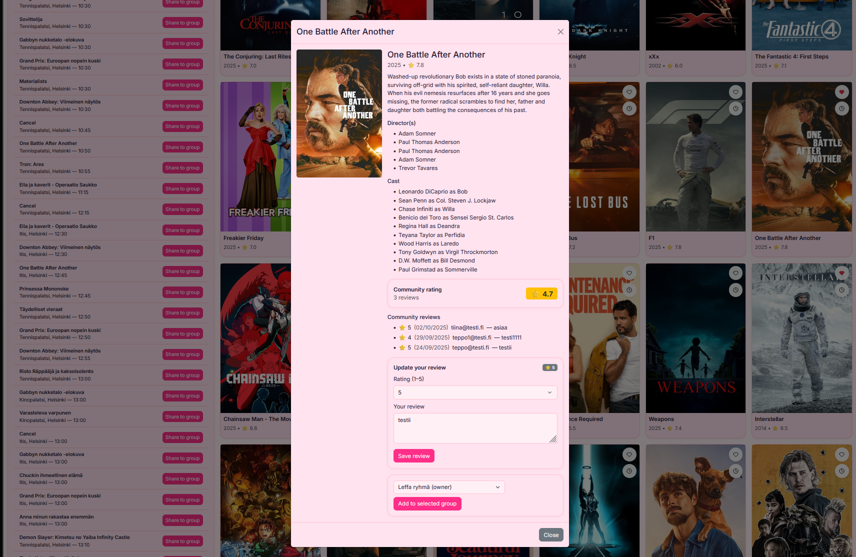
ID 12 – Review Browsing
All reviews are visible in the app with average ratings displayed on each title’s detail modal.

Slide 18
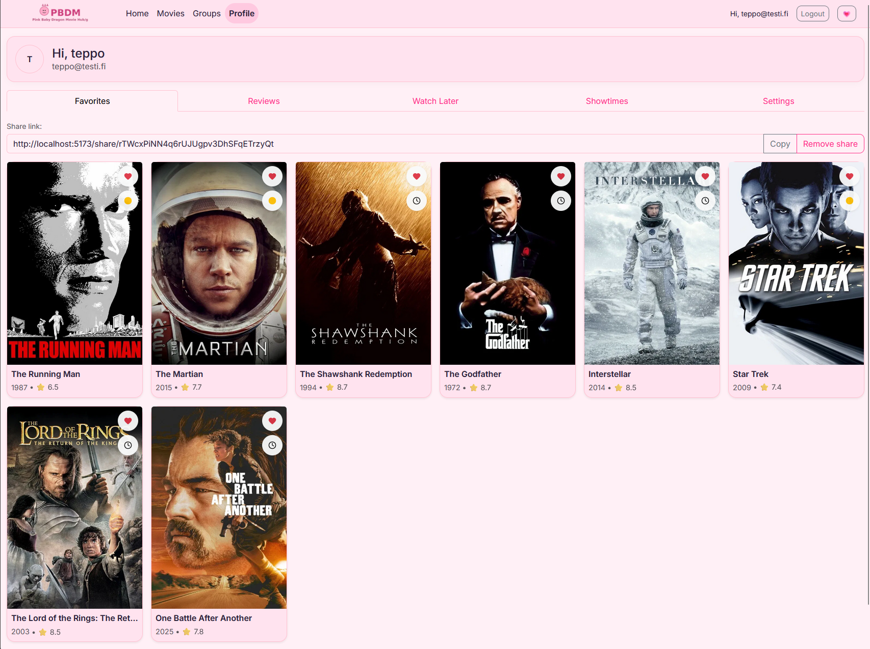
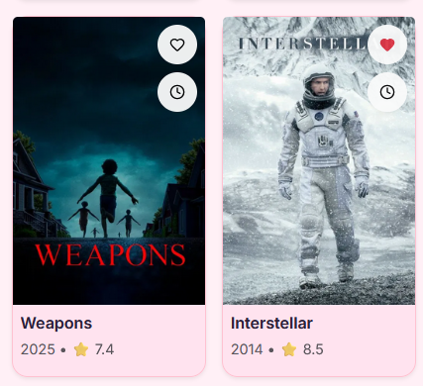
ID 13 – Favorites
Users can mark movies as favorites. Favorites are stored per user and synced instantly.

Slide 19
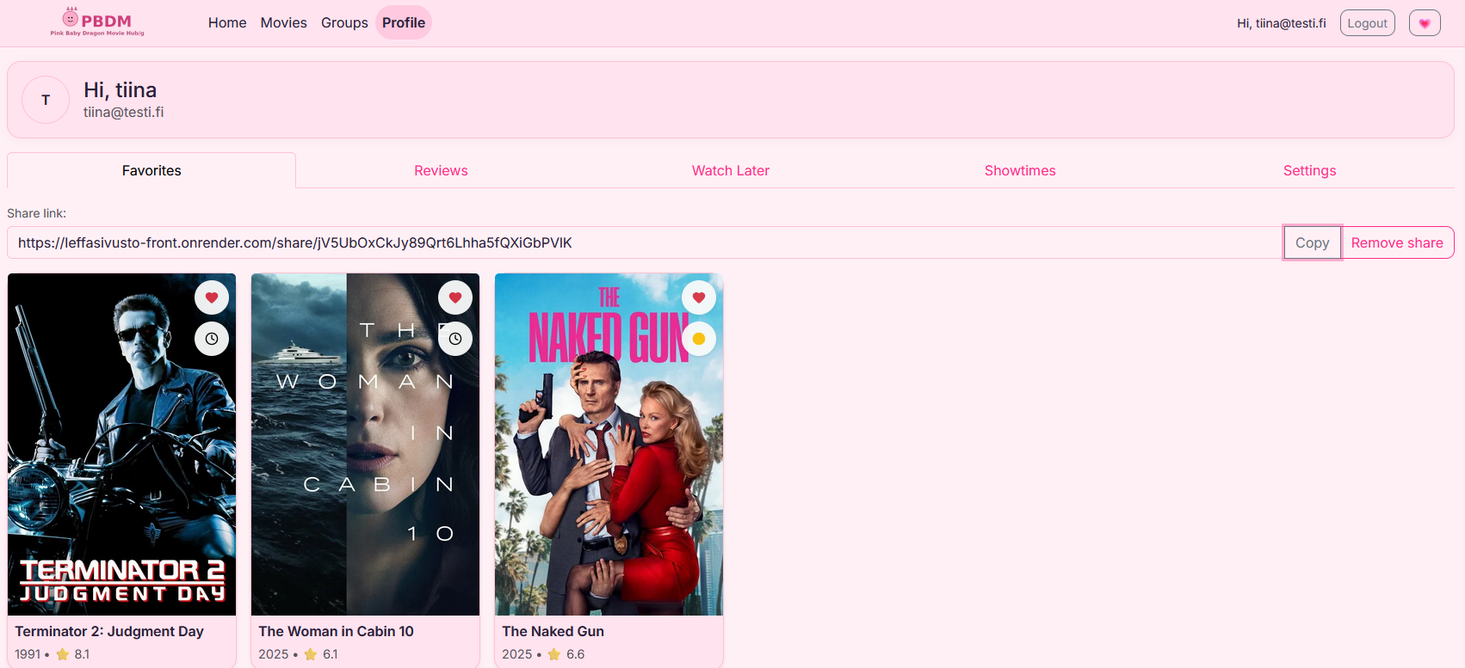
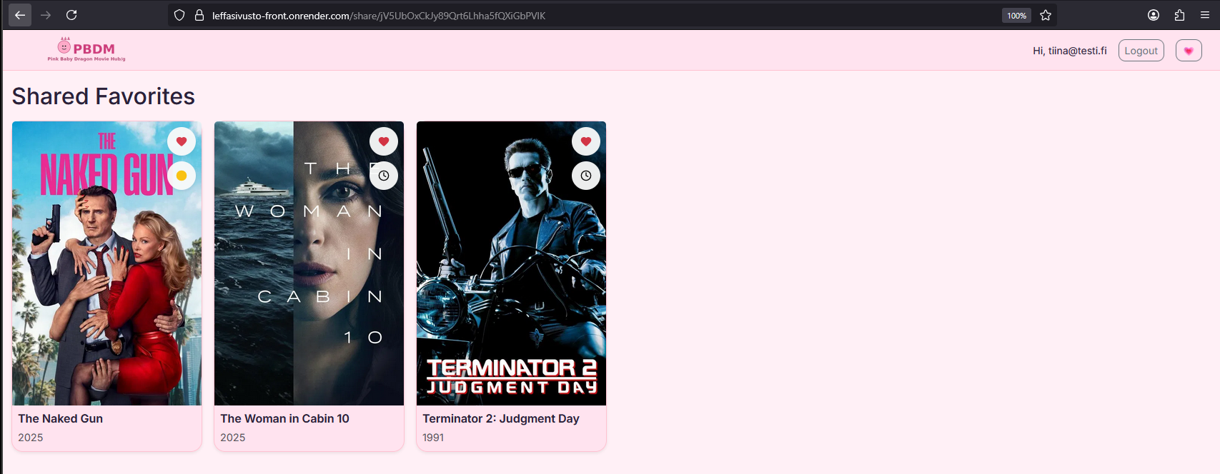
ID 14 – Sharing
Public share links allow users to share their lists or movie picks with others. Unique UUID-based URLs.

Slide 20
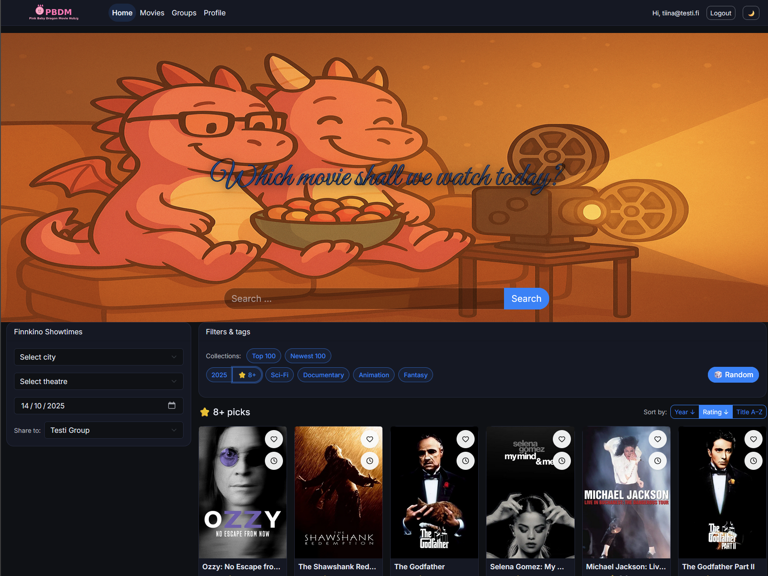
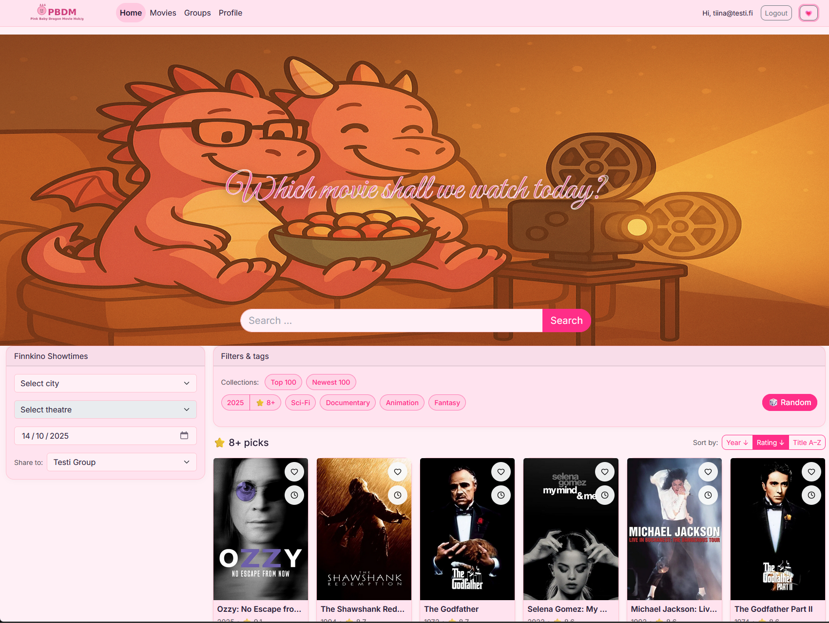
ID 15a – Theme Switcher
Light and dark themes with smooth transitions implemented via CSS variables.
[Image placeholder – Left]
[Image placeholder – Right]

Slide 21
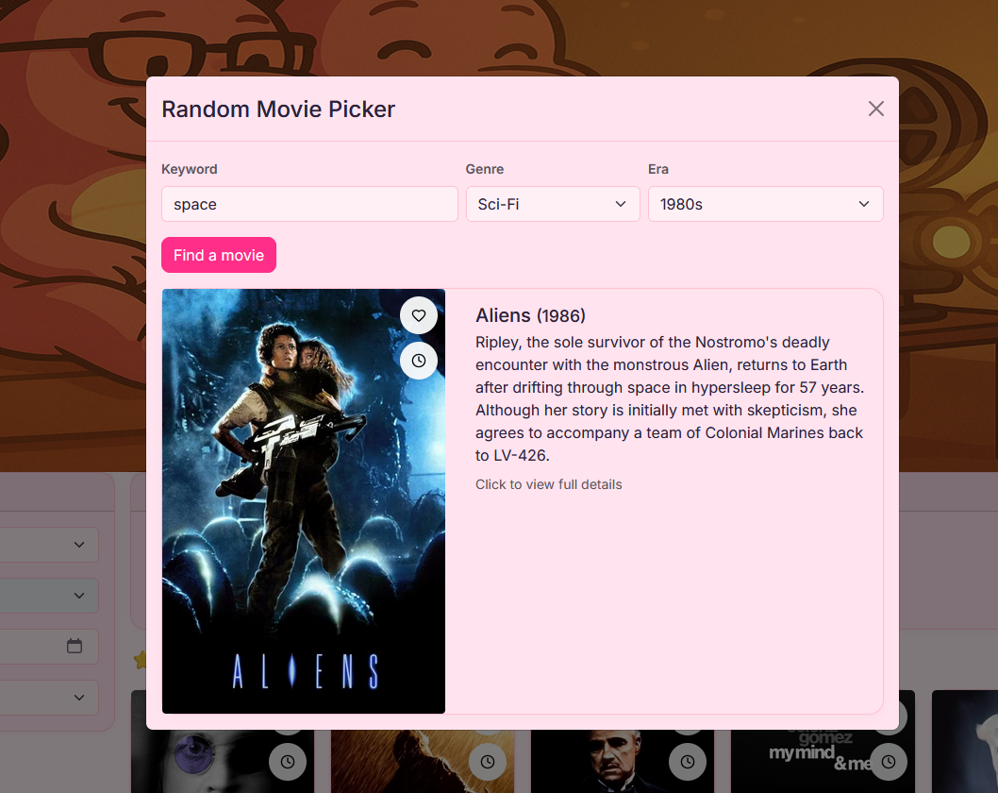
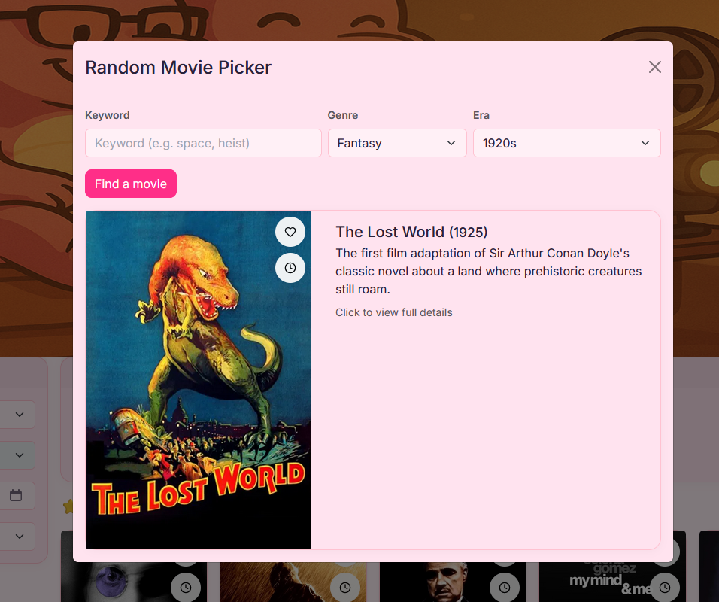
ID 15b – Random Picker
Random movie picker uses genre filters and returns one movie suggestion with instant modal view.

Slide 22
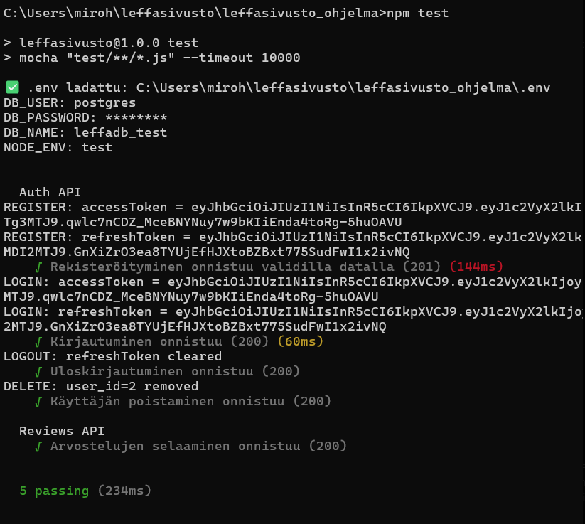
Automated Testing (Mocha / Chai / Supertest)
Automated backend tests verify REST endpoints and database operations. Includes positive and negative cases with setup hooks and clean teardown.

Slide 23
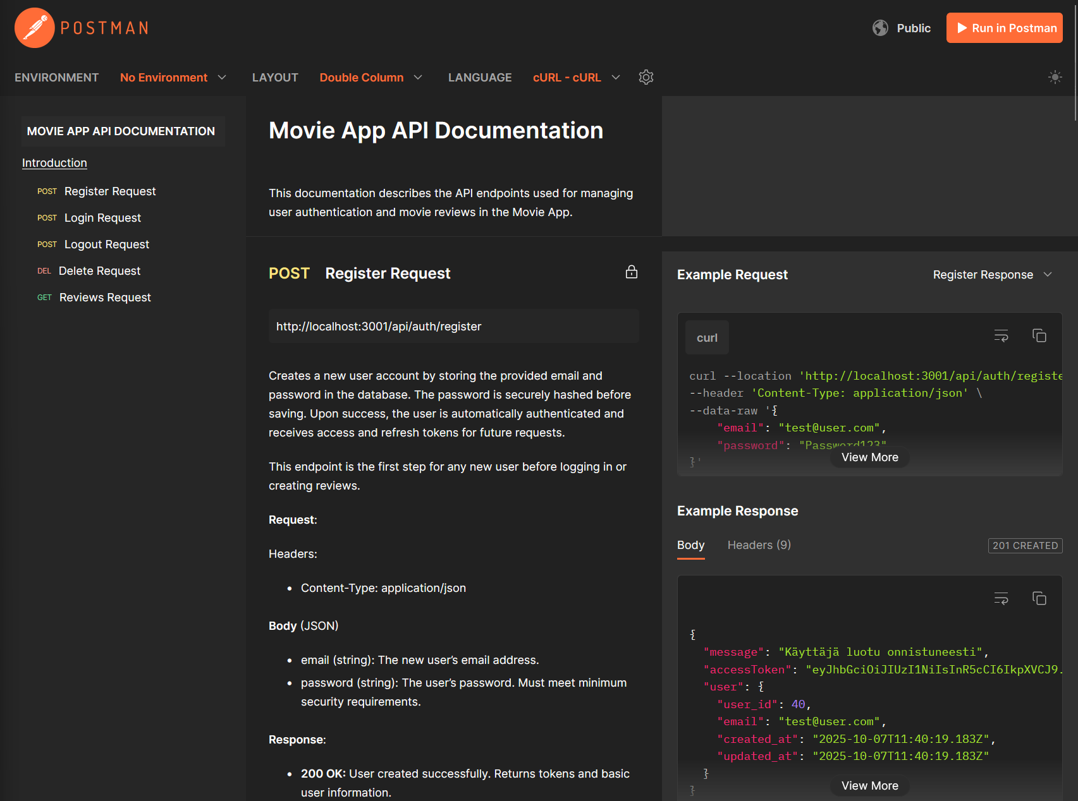
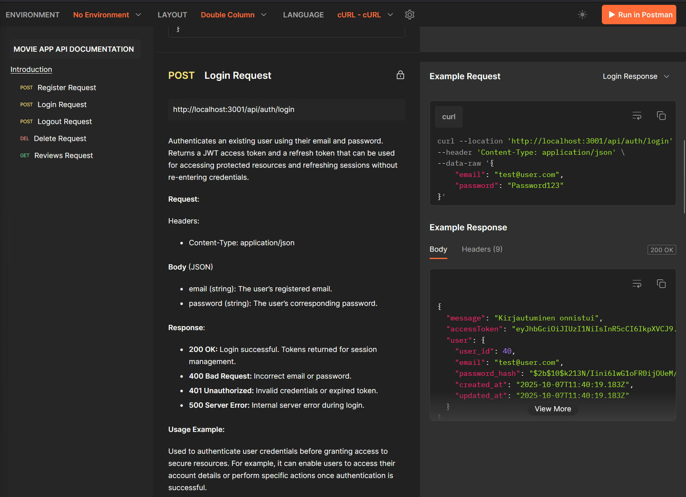
REST API Documentation (Postman)
Endpoints documented in Postman and aligned with MVC controllers. Consistent response shapes and error handling across routes.
https://documenter.getpostman.com/view/41366007/2sB3QKsqMR

Slide 24
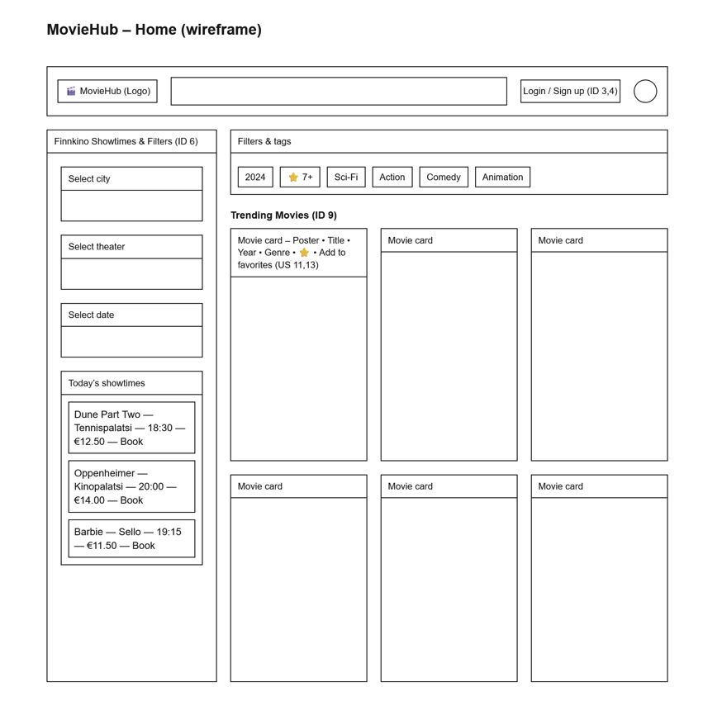
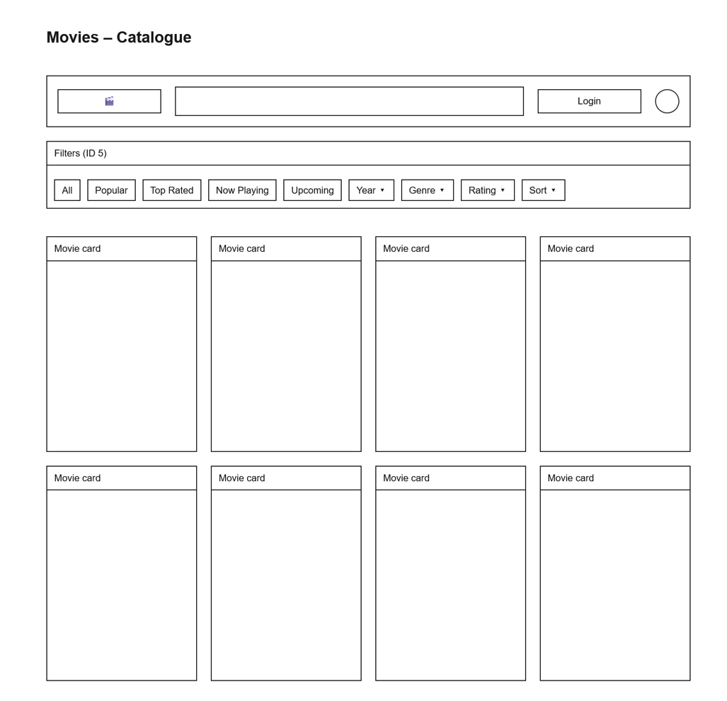
From Wireframe to Final UI
Initial wireframes guided the component structure. Final design is responsive and accessible with Bootstrap grid and semantic HTML.

Slide 25
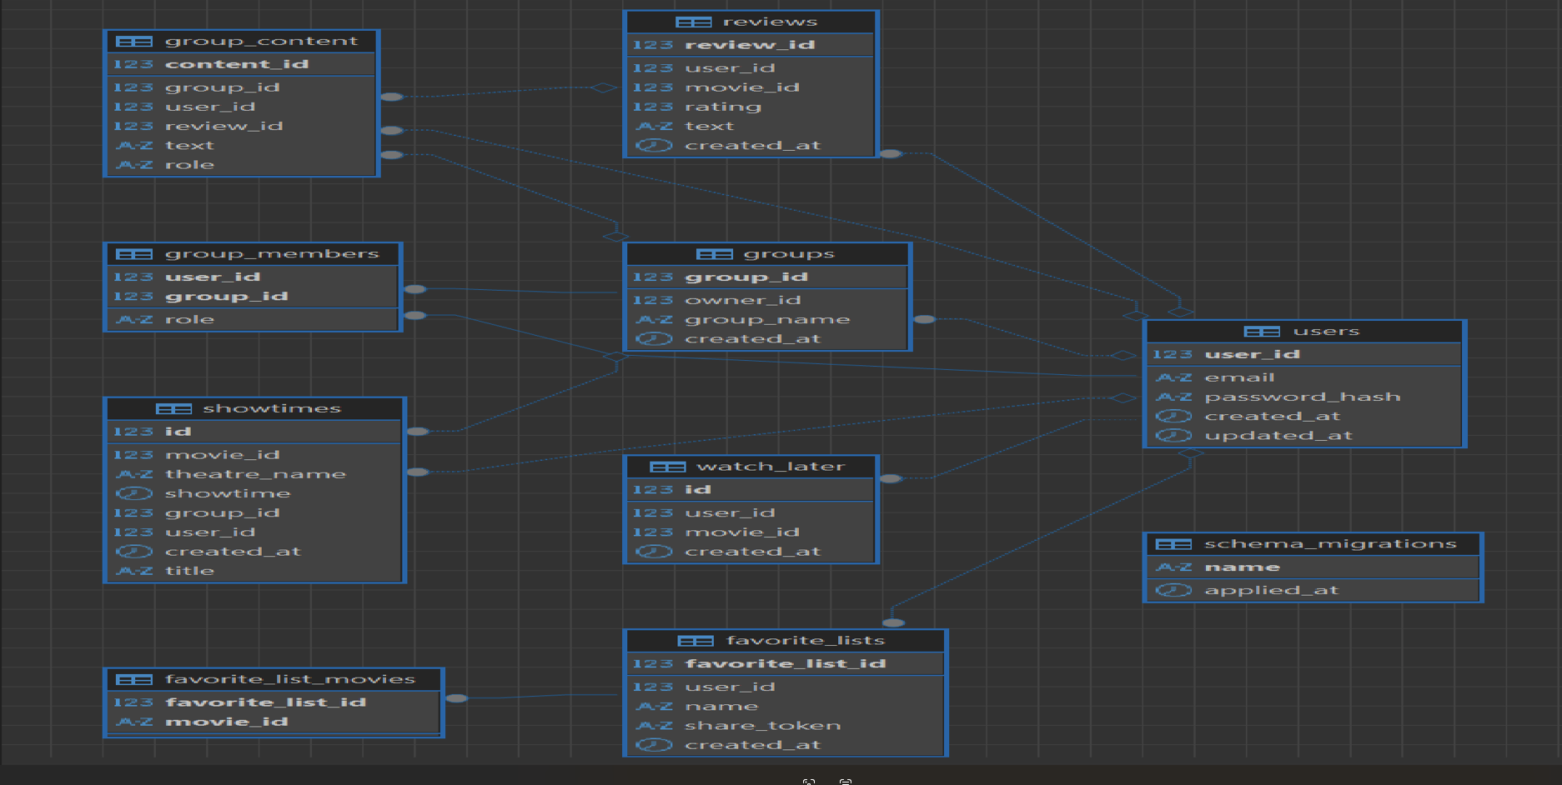
ER Diagram

Slide 26
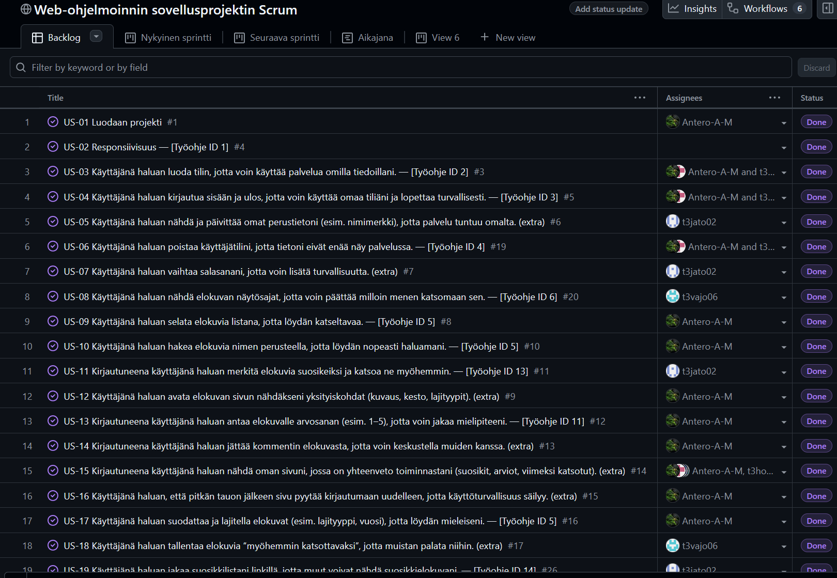
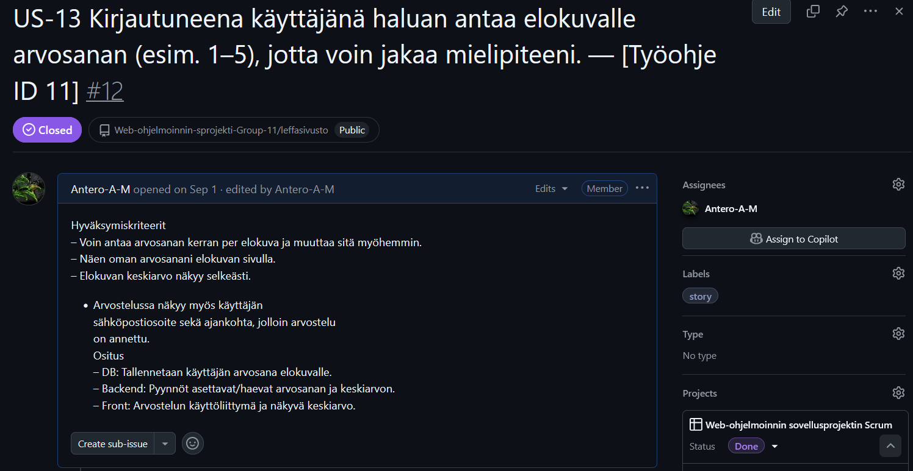
Project Management – Scrum & Backlog
We planned sprints, tracked tasks in the backlog, and reviewed progress at the end of each sprint. Team communication and clear roles kept the project moving like a train.

Slide 27
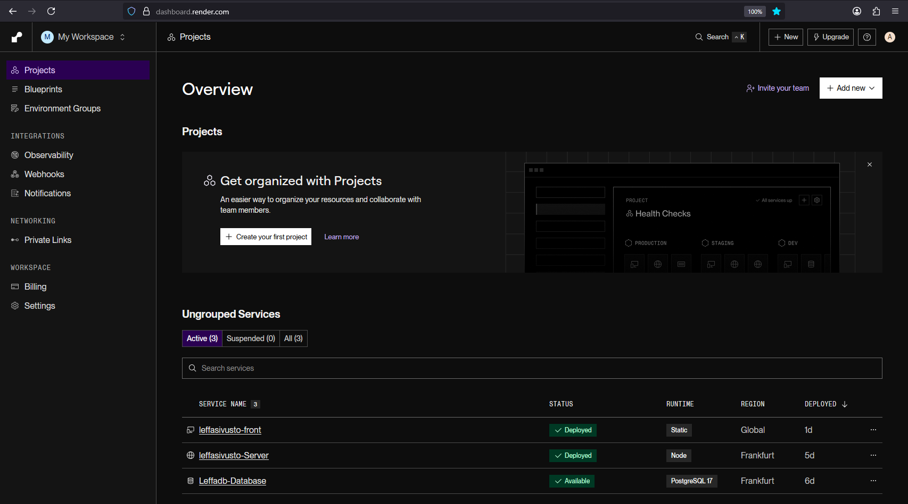
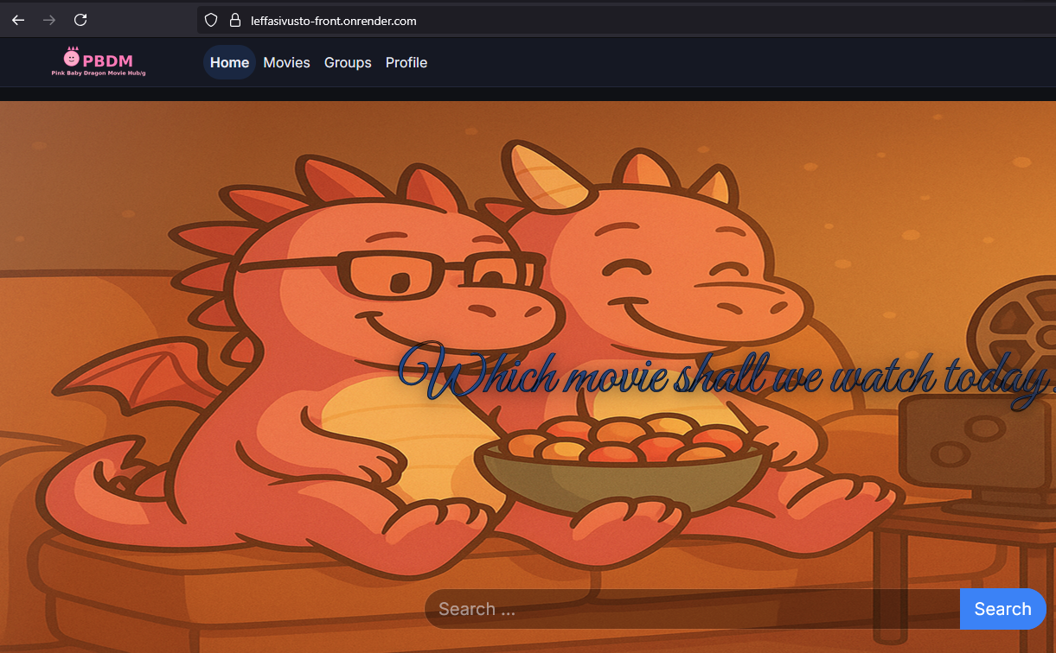
Deployment (Render.com)
Backend and frontend deployed to Render with environment configuration and CORS. Health checks and logs monitored for stability.
https://leffasivusto-front.onrender.com/

Slide 28
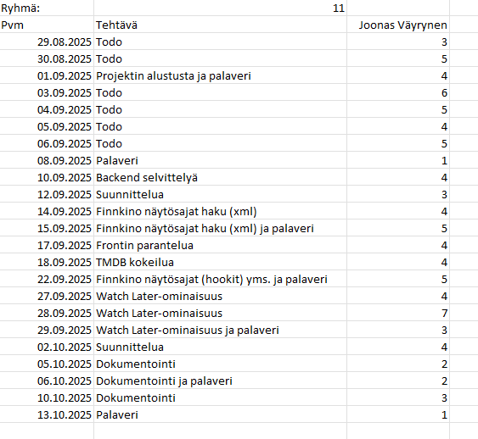
Work Hours – Joonas Väyrynen
[Excel work-hour summary screenshot]

Slide 29
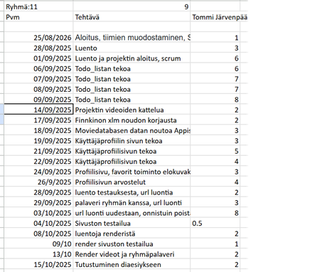
Work Hours – Tommi Järvenpää

Slide 30
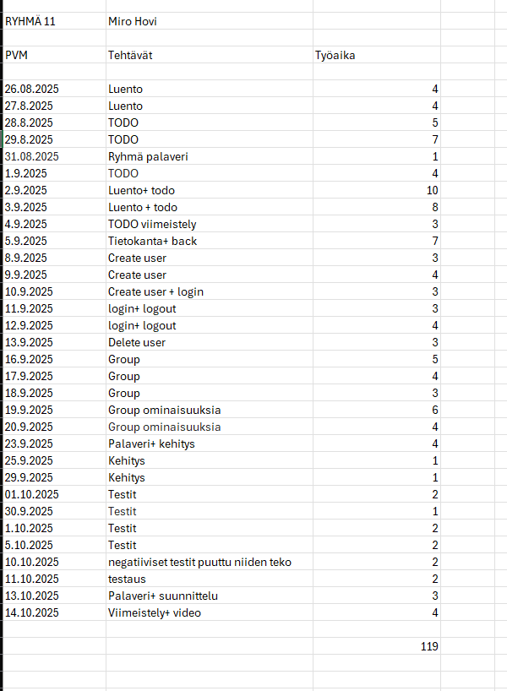
Work Hours – Miro Hovi
[Excel work-hour summary screenshot]

Slide 31
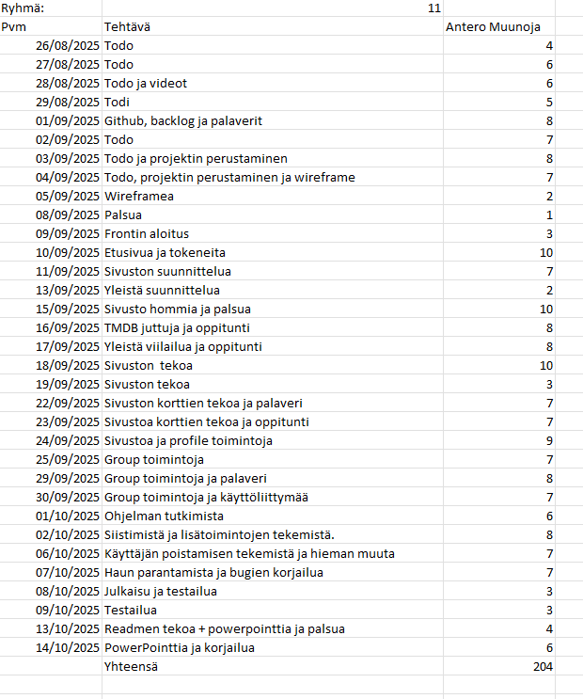
Work Hours – Antero Muunoja
[Excel work-hour summary screenshot]

Slide 32
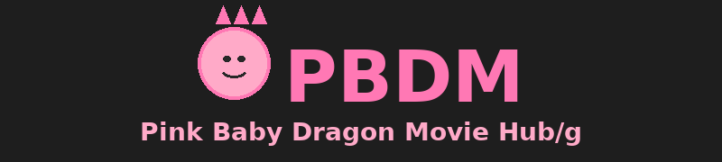



All Mandatory Features Implemented
All required functionalities and documentation completed. Additional improvements and polish delivered.

